Slide 1




Forest Fire Detection using
Deep Learning
Name : Vappangi Roshitha
AICTE Internship Student Registration ID : STU64f443e58214e1693729765

Slide 2

Learning Objectives
Understand the use of CNNs for image-based classification
Learn dataset preprocessing and augmentation techniques
Train and evaluate deep learning models.
Develop practical applications using AI for disaster management.
Source of dataset:
https://www.kaggle.com/datasets/elmadafri/the-wildfire-dataset
Goal
To develop a deep learning model that accurately detects forest fires from images to aid in early warning and disaster prevention.
GITHUNB LINK:
https://github.com/Roshitha16/P2_FOREST_FIRE_DETECTION_USING_DL.git
GOAL
Source :
www.freepik.com/

Slide 3
Tools and Technology used
Python
TensorFlow / Keras
Matplotlib, NumPy, Pandas
Jupyter Notebook
Google Colab

Slide 4
Methodology
Data Acquisition from Kaggle.
Data Preprocessing: Image resizing, normalization.
Model Building: CNN with Conv2D, MaxPooling, Flatten, Dense layers.
Training: On labeled image dataset (fire vs. no fire).
Validation & Testing: Using separate datasets.
Evaluation: Accuracy, loss graphs, and test results.

Slide 5
Problem Statement:
Wildfires cause devastating damage to forests, wildlife, and human settlements. Manual detection is time-consuming and delayed. There's a need for an automated and fast detection system using AI.
“Forest fires spread rapidly and often go undetected until it’s too late. Manual monitoring is time-consuming and inefficient. An automated detection system is crucial for rapid intervention.”

Slide 6
Solution:
A Convolutional Neural Network (CNN)-based model trained on satellite and drone images to detect signs of forest fires. It distinguishes between images with fire and without fire in real-time or near real-time.
A CNN-based image classification model is trained on fire and non-fire images
The system can detect fire presence with high accuracy
Can be integrated with surveillance drones or satellite systems for real-time monitoring

Slide 7
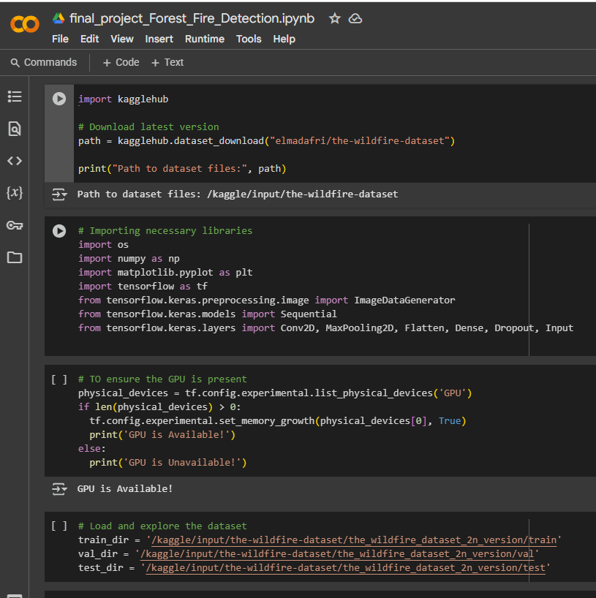
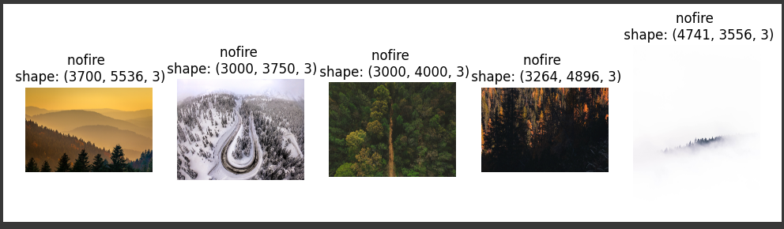
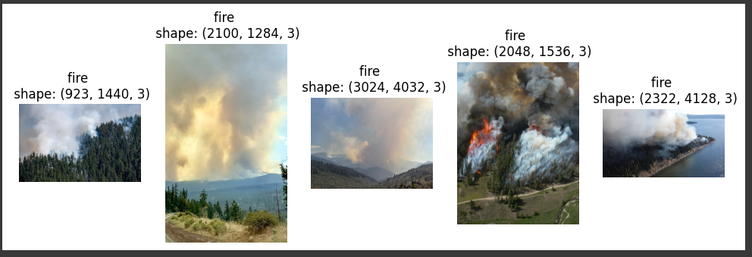
Screenshot of Output:
visualize the images in the dataset:

Slide 8
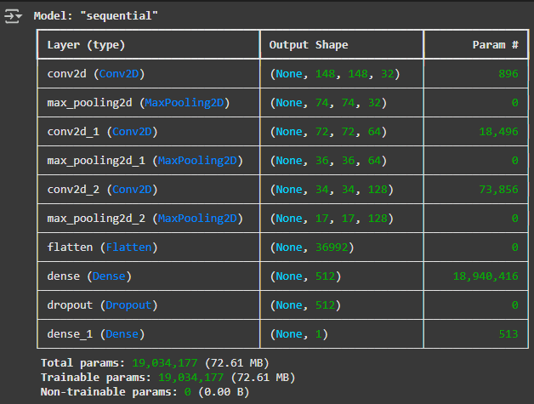
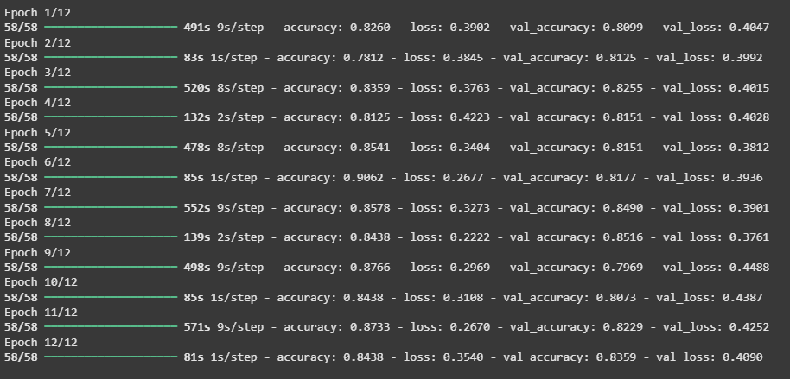

Slide 9
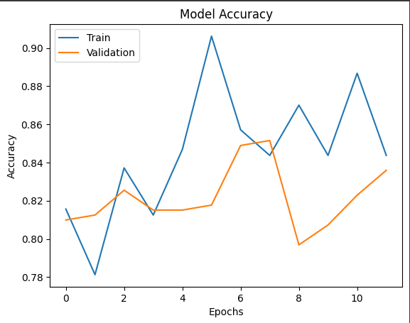
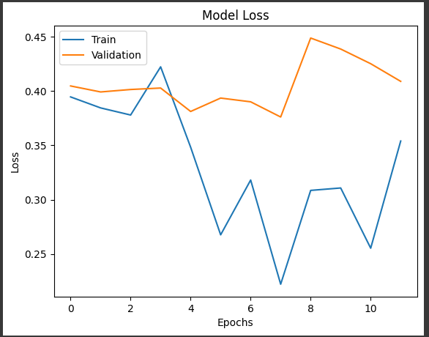
plotting training and validation

Slide 10
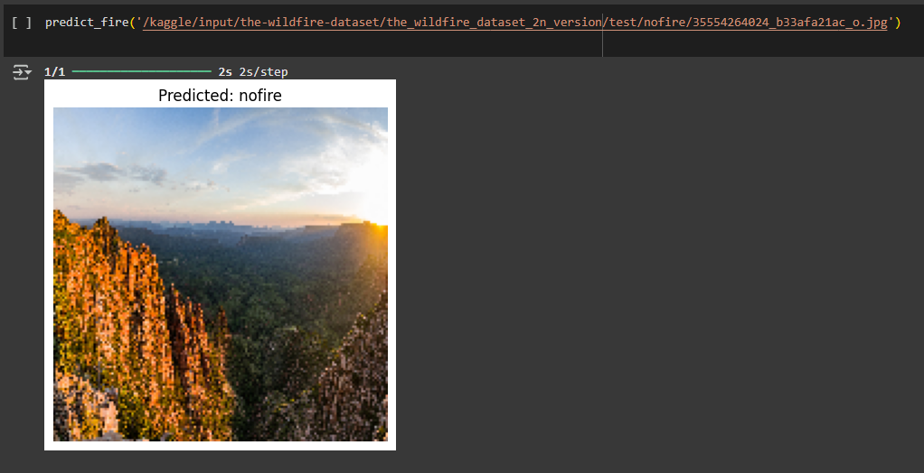
Final output:

Slide 11
Conclusion:
Successfully built a CNN model to classify forest fire images.
Achieved reliable accuracy using simple architecture.
Can be deployed in real-world applications for forest monitoring.
Future scope includes integration with drones or IoT for live monitoring.

Slide 12
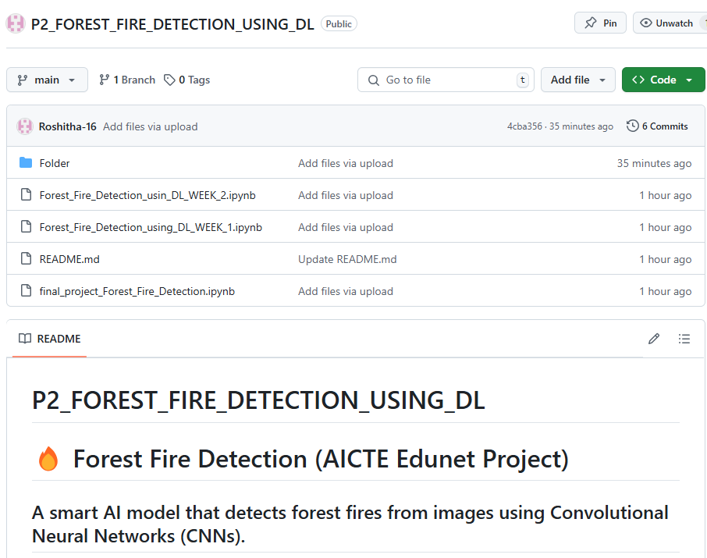
github link :
https://github.com/Roshitha-16/P2_FOREST_FIRE_DETECTION_USING_DL.git

Slide 13
Future Scope
Real-Time Integration:
Deploy the model on drones or satellites for continuous forest surveillance and real-time fire alerts.
Geolocation-Based Detection:
Combine with GPS data to pinpoint exact fire locations and assist in dispatching emergency response teams.
Cloud & IoT Integration:
Connect with IoT sensors and cloud platforms for automated data collection and scalable monitoring systems.
Model Optimization:
Improve accuracy by using larger and more diverse datasets; explore advanced architectures like ResNet or EfficientNet.

